Slide 1
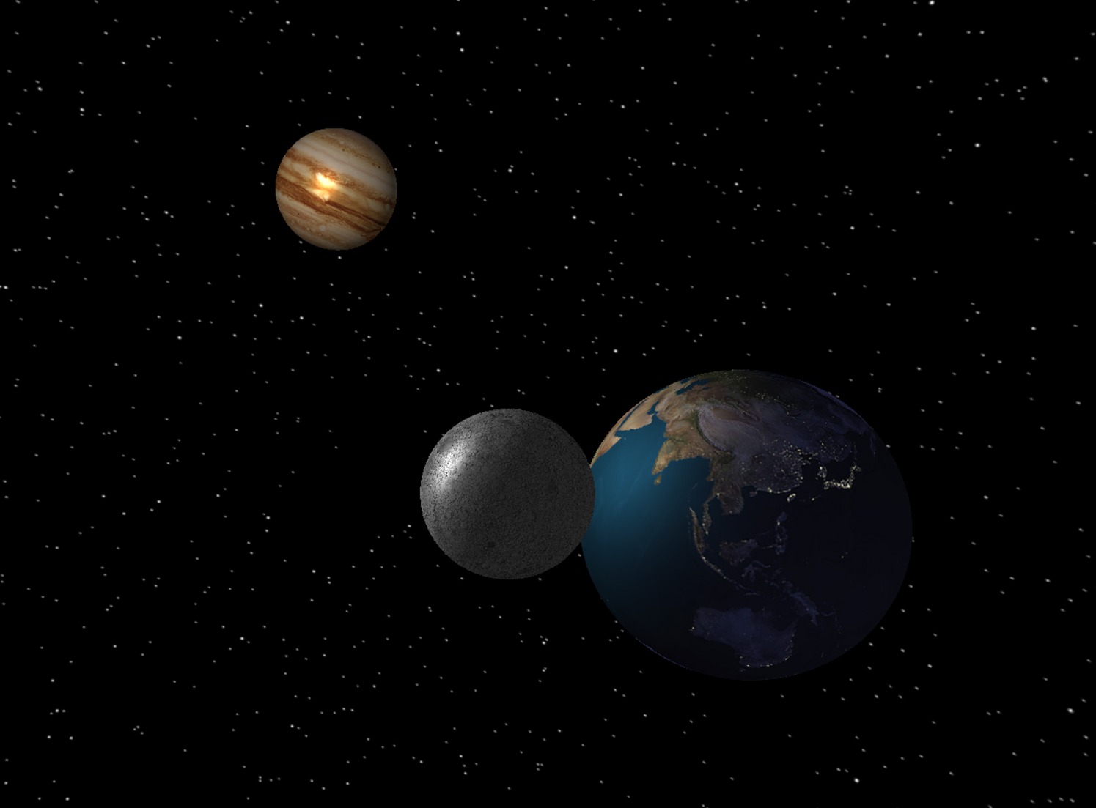
Computer Graphics TSBK07 Celestial Motion Simulator

Slide 2
What is CMS?
A fully customizable interactive solar system
User friendly menus for planet creation, editing and placement
Gravity model
Collision detection
Multi texturing
Shadows

Slide 3
How was CMS created?
C++ in Visual Studio
GLeW
OpenGL 4
OpenCV 2.4
A lot of experience from previous courses
Good Matrix Library
SFML 2.0
Window management
Event managing (Keyboard, Mouse)

Slide 4
Models
Sphere Generator
Generates spheres with texture of arbitrary size
.Obj-Loader
Loads .obj files as long as they are stored according to openGL desires.

Slide 5
Texture
Texture blending
Day texture
Night texture
Texture for structure
Normal map
Specularity map
For both planes and spheres!

Slide 6
Shadows
All planets cast shadows in real time
Shadows are generated using raycasting calculated with Plücker coordinates.

Slide 7
Data Structures
One object class representing both items and Planets.
Items – Affected by gravity
Planets – Locked in orbit
Stored in different lists
Each planet has a list with all satellites (planets) locked in orbit around it.
Allows for an arbitrary number of satellites.
Allows for easy access to all information needed.

Slide 8

Physics
Gravity according to Newton’s laws
Sum acceleration contributions from all planets
Proportional to planet mass
Update velocities as:
Can be toggled to affect the Camera as well.
Use with caution!

Slide 9
Physics
Friction free spherical collision
Un-optimized
Check all items against all planets and other items
Still able handle up to 100 items without significant FPS drop

Slide 10
Editor
Great user friendly console menus with only a few unintended features
Planet creation
Pick your own textures
Pick normal maps
Set shading parameters
Add satellite to existing planet
Planet presets
The whole solar system

